Slide 1

Operating Systems
Jinghui Zhong （钟竞辉）
Office：B3-515
Email ：jinghuizhong@scut.edu.cn

Slide 2

单选题
1分
The virtual address space has 8 pages, each page has 1024B, they are mapped to 32 blocks of physical memory. What is the number of valid bits of virtual address? (), what is the minimum number of bits of physical address?()
A
10、11
B
12、14
C
13、15
D
14、16
提交

Slide 3
单选题
1分
Which of the following methods can improve the address translation efficiency（ ）
a) Increase the capacity of TLB;
b) Keep the page table in memory;
c) Increase swap region.
A
Only a
B
Only b
C
Only a, b
D
Only b, c
提交

Slide 4
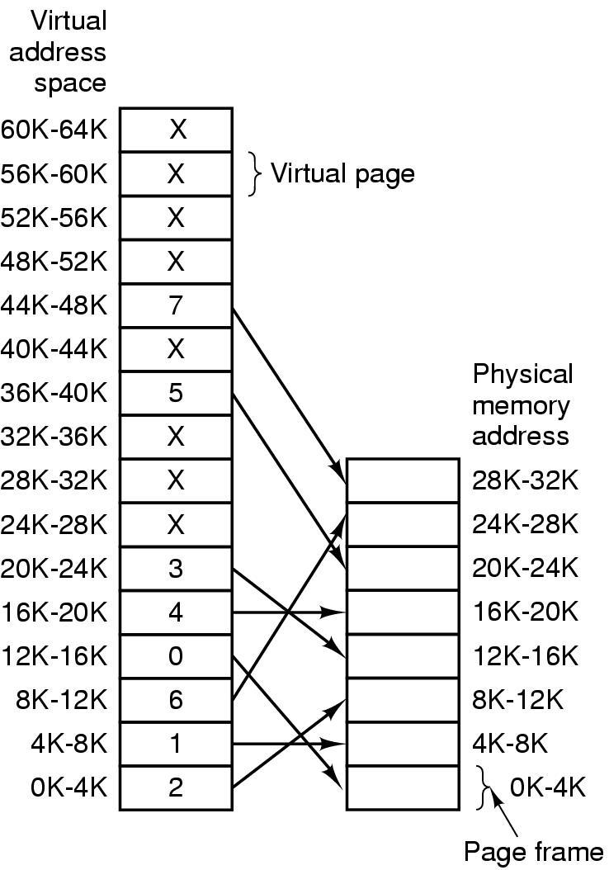
Page Replacement Algorithms
Page fault forces choice
which page must be removed
make room for incoming page
Modified page must first be saved
unmodified just overwritten
Better not to choose an often used page
will probably need to be brought back in soon
4

Slide 5
Optimal Page Replacement Algorithm
Replace the page which will be referenced at the farthest point.
Optimal but impossible to implement.
5

Slide 6
Not Recently Used Page Replacement Algorithm
Each page has Reference bit (R) and Modified bit (M).
bits are set when page is referenced (read or written recently), modified (written to)
when a process starts, both bits R and M are set to 0 for all pages.
periodically, (on each clock interval (20msec) ), the R bit is cleared. (i.e. R=0).
Pages are classified
Class 0: not referenced, not modified
Class 1: not referenced, modified
Class 2: referenced, not modified
Class 3: referenced, modified
NRU removes page at random
from lowest numbered non-empty class
6

Slide 7
FIFO Page Replacement Algorithm
Maintain a linked list of all pages
Pages came into memory with the oldest page at the front of the list.
Page at beginning of list replaced
Advantage?
easy to implement
Disadvantage?
page in memory the longest (perhaps often used) may be evicted
7

Slide 8
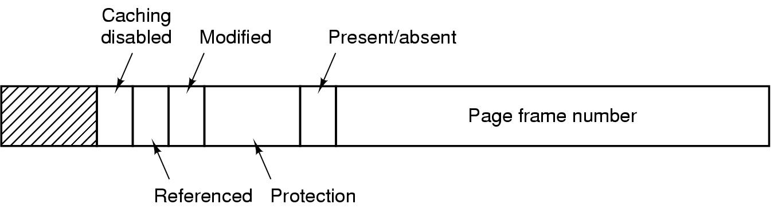
Second Chance Page Replacement Algorithm
Inspect R bit:
if R = 0 ➔ evict the page
if R = 1 ➔ set R = 0 and put page at end (back) of list. The page is treated like a newly loaded page.
8

Slide 9
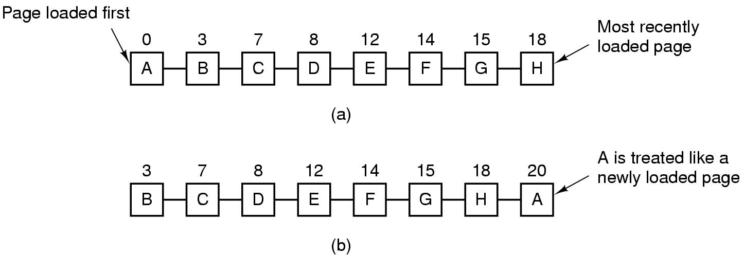
Second Chance Page Replacement Algorithm
Operation of a second chance
Pages sorted in FIFO order
Page list if fault occurs at time 20, A has R bit set (numbers above pages are loading times)
9

Slide 10
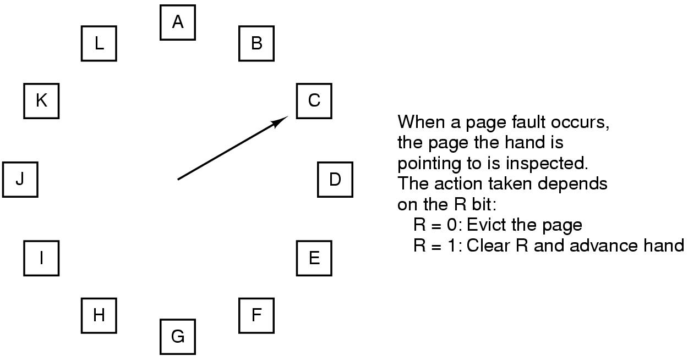
The Clock Page Replacement Algorithm
10

Slide 11
Least Recently Used (LRU)
Assume pages used recently will used again soon
throw out page that has been unused for longest time
Software Solution?
Must keep a linked list of pages: most recently used at front, least at rear; update this list every memory reference Too expensive!!
Hardware solution?
Equip hardware with a 64 bit counter.
11

Slide 12
Least Recently Used (LRU)
Hardware solution: Equip hardware with a 64 bit counter.
That is incrementing after each instruction.
The counter value is stored in the page table entry of the page that was just referenced.
choose page with lowest value counter
periodically zero the counter
Problem?
page table is very large, become even larger.
Maintain a matrix of n x n bits for a machine with n page frames.
When page frame K is referenced:
(i) Set row K to all 1s.
(ii) Set column K to all 0s.
The row whose binary value is smallest is the LRU page.
12

Slide 13
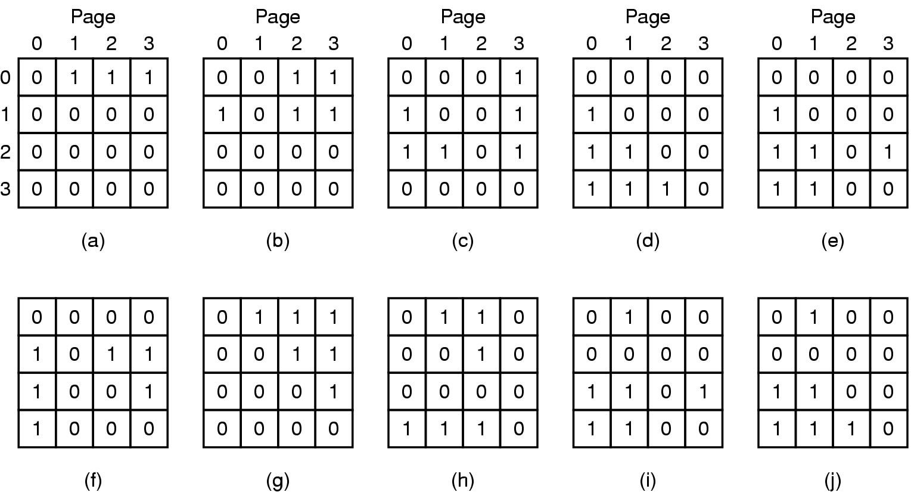
Simulating LRU in Software
LRU using a matrix – pages referenced in order 0,1,2,3,2,1,0,3,2,3
13

Slide 14
Simulating LRU in Software
LRU hardware is not usually available. NFU (Not Frequently Used) is implemented in software.
At each clock interrupt, the R bit is added to the counter associated with each page. When a page fault occurs, the page with the lowest counter is replaced.
Difference? Problem?
NFU never forgets, so a page referenced frequency long ago may have the highest counter.
Modified NFU = NFU with Aging - at each clock interrupt:
The counters are shifted right one bit, and
The R bits are added to the leftmost bit.
In this way, we can give higher priority to recent R values.
14

Slide 15
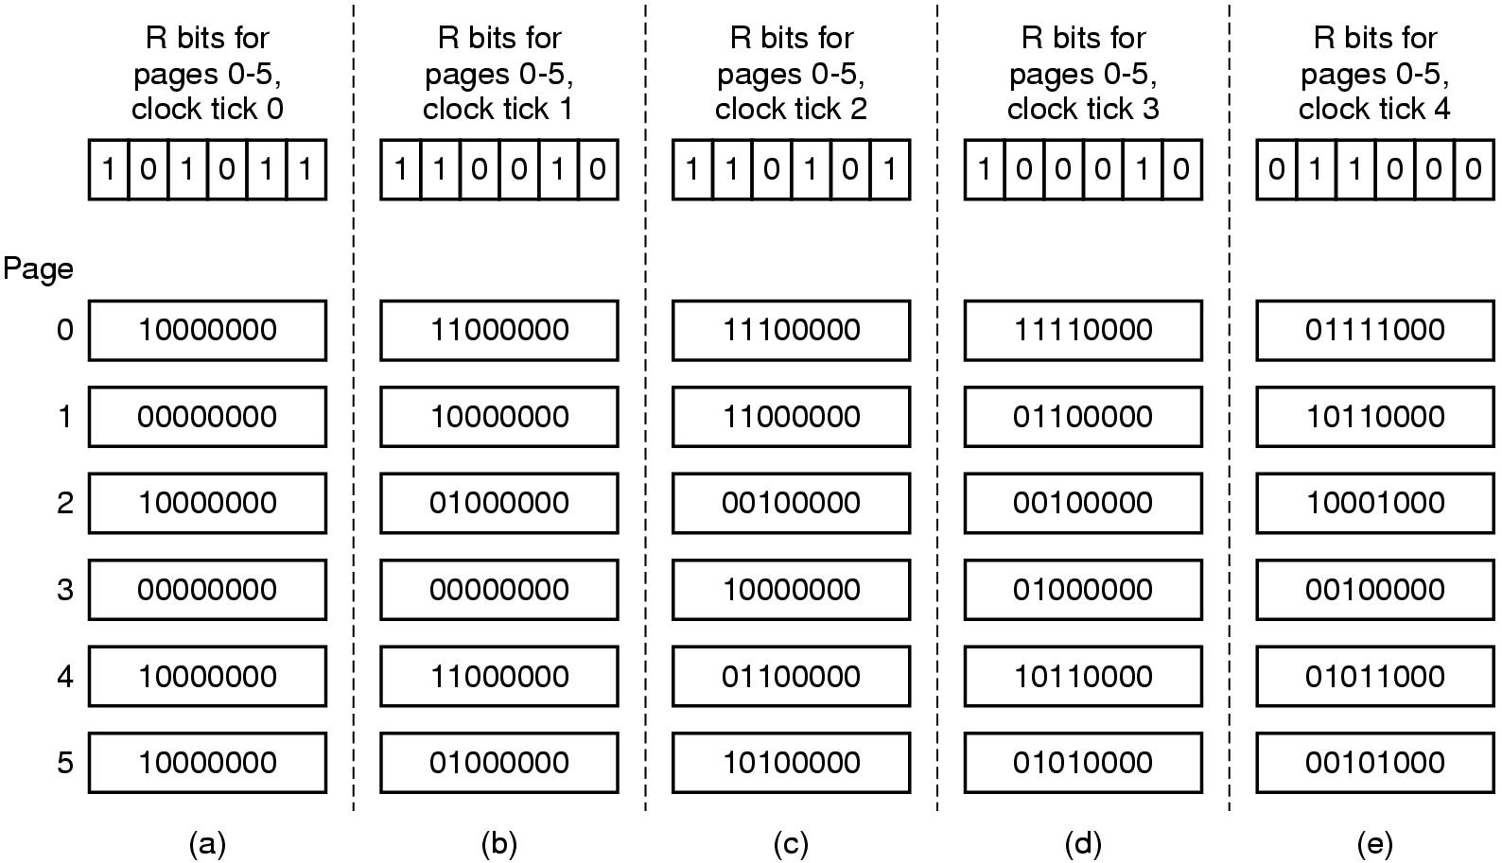
Simulating LRU in Software
The aging algorithm simulates LRU in software
Note 6 pages for 5 clock ticks, (a) – (e)
15

Slide 16
Working-Set Model
Pages are loaded only on demand. This strategy is called demand paging.
During the phase of execution the process references relatively small fraction of its pages. This is called a locality of reference.
The set of pages that a process is using currently is called its working set.
A program causing page faults every few instructions is said to be thrashing.
Paging systems keep each process’s working set in memory before letting the process run. This approach is called the working set model.
16

Slide 17
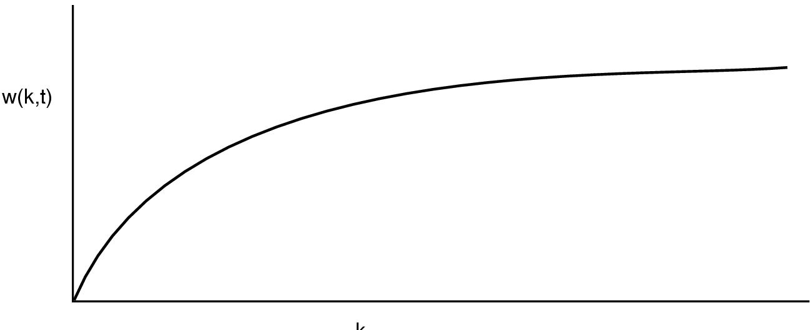
Working-Set Model
Loading the pages before letting processes run is called prepaging.
The working set is the set of pages used by the k most recent memory references, w(k,t) is the size of the working set at time t.
k
17

Slide 18
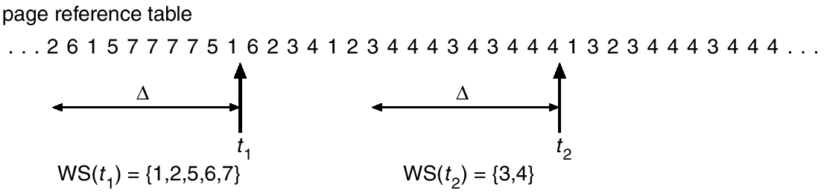
Working-set model
18

Slide 19
Working-Set Model
The idea is to examine the most recent page references. Evict a page that is not in the working set.
The working set of a process is the set of pages it has referenced during the past τ seconds of virtual time (the amount of CPU time a process has actually used).
Scan the entire page table and evict the page:
R= 0, its age is greater than τ.
R = 0, its age is not greater than τ and its age is largest.
R = 1, randomly choose a page.
The basic working set algorithm is expensive. Instead, WSCLock is used in practice.
19

Slide 20
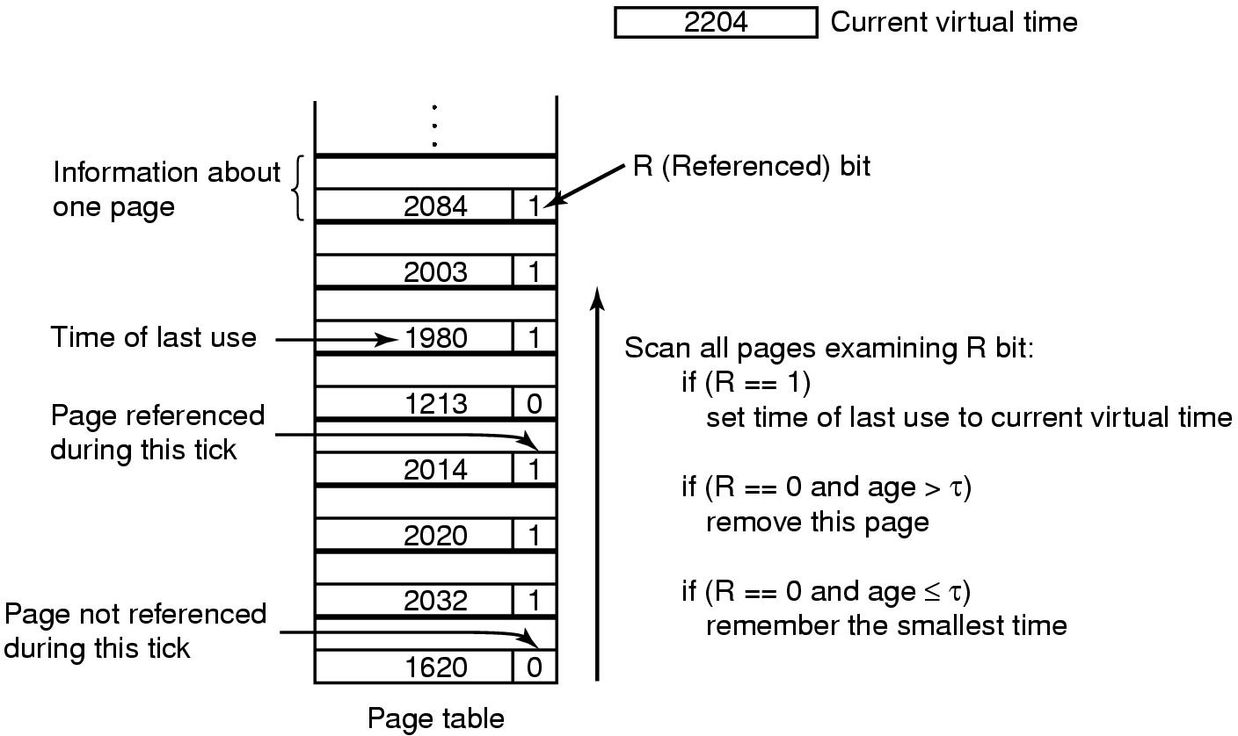
The Working Set Page Replacement Algorithm
The working set algorithm
20

Slide 21
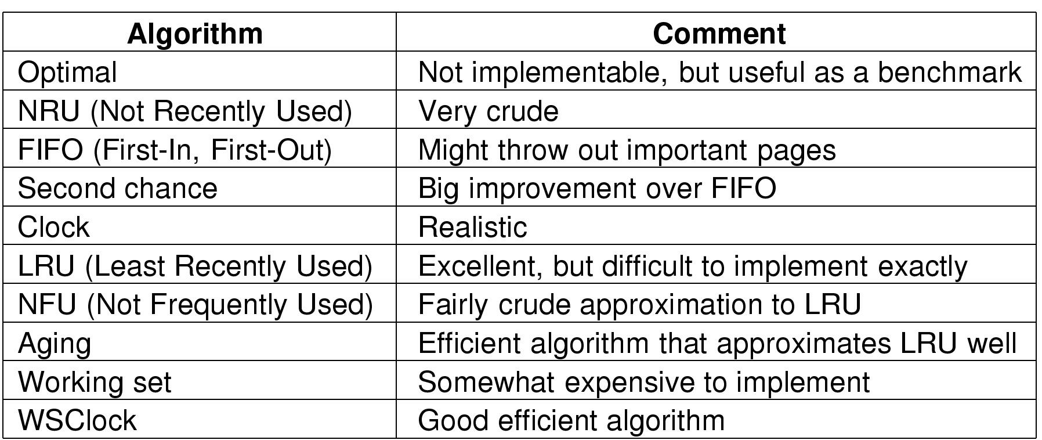
Review of Page Replacement Algorithms
21

Slide 22
单选题
1分
The purpose of using modification bit is to （ ）
A
Implement LRU method
B
Implement NRU method
C
Check whether a page is in the TLB or not
D
Check whether a page has been modified or not
提交

Slide 23
单选题
1分
Demand paging is a good virtual memory management strategy. However, some programming technologies are not suitable for this environment, e.g.,（ ）
A
Stack
B
Linear search
C
Vector calculation
D
Binary search
提交

Slide 24
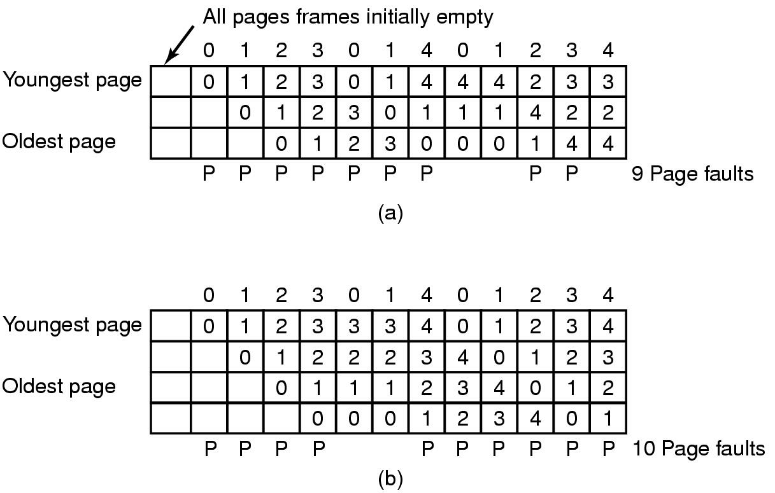
Modeling Page Replacement Algorithms
Belady’s anomaly:
More page frames might not always have fewer page faults.
24

Slide 25
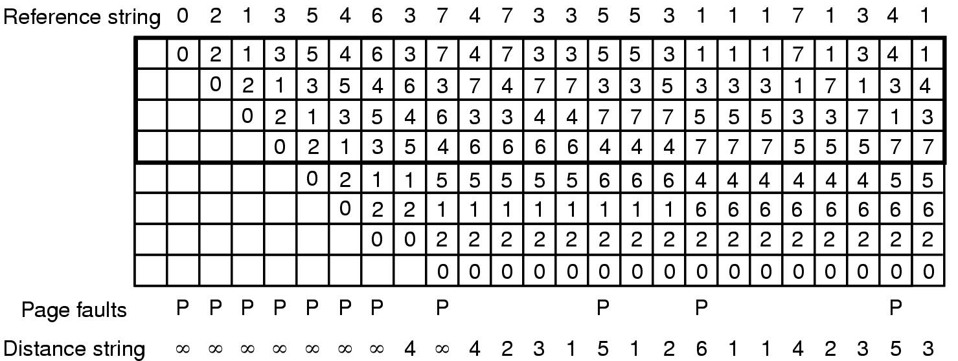
Modeling Page Replacement Algorithms
Modeling LRU Algorithms:
When a page is referenced, it is always moved to the top entry in pages in memory.
If the page referenced was already in memory, all pages above it move down one position. Pages that below the referenced page are not moved.
25

Slide 26
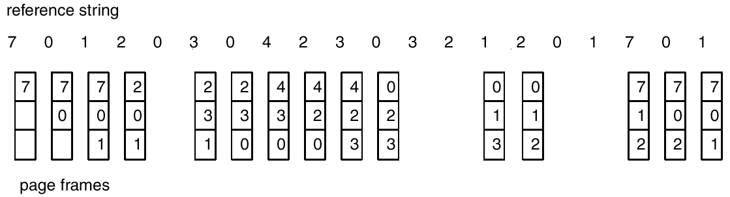
Page Replacement
3 Frames
FIFO ：15 page faults
LRU ：12 page faults
26

Slide 27
Stack Replacement Algorithms
A page replacement algorithm is called a stack replacement algorithm if the set of pages in a k-frame memory is always a subset of the pages in a (k + 1) frame memory.
M is the set of memory array, after each item in reference string is processed，m is the number of page frames, then M(m)⊆ M(m+1).
27

Slide 28
单选题
1分
A request paging system using LRU page replacement algorithm. The coming page request of a job is: 1, 3, 2, 1, 1, 3, 5, 1, 3, 2, 1, 5. Suppose the number of physical blocks assigned to the job is 3 and 4 respectively, what is the page fault rate of the two cases?（）
A
25%，33%
B
25%，100%
C
50%，33%
D
50%，75%
提交

Slide 29
单选题
1分
The system allocates four page frames for a process, and the page number sequence of the process accessed is 2, 0, 2, 9, 3, 4, 2, 8, 2, 4, 8, 4, 5. If the page number of the next page to be accessed by the process is 7, according to LRU algorithm, what is the page number of the page to be eliminated ?（ ）
A
2
B
3
C
4
D
8
提交

Slide 30
单选题
1分
The advantage of multi-level page table is （ ）
A
Speed up address translation
B
Reduce the number of page faults
C
Reduce the number of bytes occupied by page table entries
D
Reduce the continuous memory space occupied by page table
提交

Slide 31
单选题
1分
The main causes of memory thrashing is （ ）
A
Disk space is too small
B
CPU running speed is too slow
C
CPU scheduling algorithm is not good
D
Page replacement algorithm is not good
提交

Slide 32
Some issues related to paged memory management
Local /Global allocation
Page Size
Share pages
Paging Damon
Page Fault
Locking Pages
Backing Store
32

Slide 33
Paged Memory Management
Address generated by CPU is divided into:
Page number (p) – used as an index into a page table which contains base address of each page in physical memory.
Page offset (d) – combined with base address to define the physical memory address that is sent to the memory unit.
page number page offset
m – n n
Where p is an index to the page table and d is the displacement within the page.
p | d
33

Slide 34
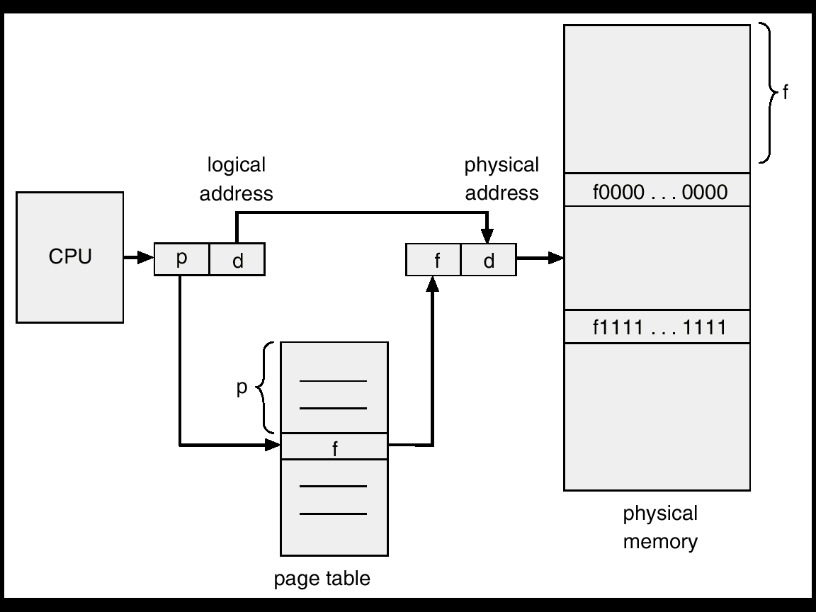
Paged Memory Management
34

Slide 35
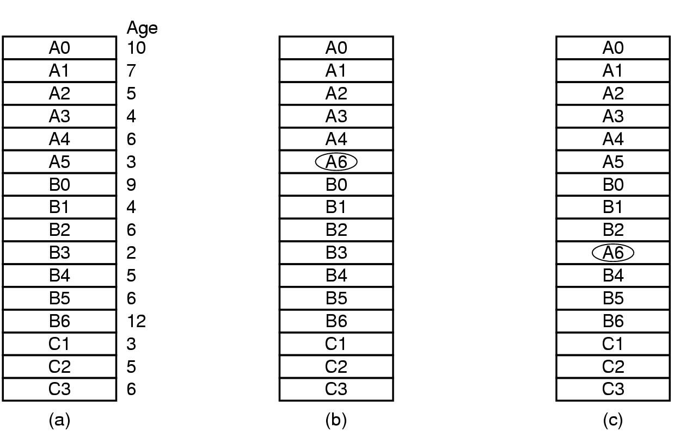
Local versus Global Allocation Policies
Global algorithms dynamically allocate page frames among all runnable processes. Local algorithms allocate pages for a single process.
Original configuration
Local page replacement
Global page replacement
35

Slide 36
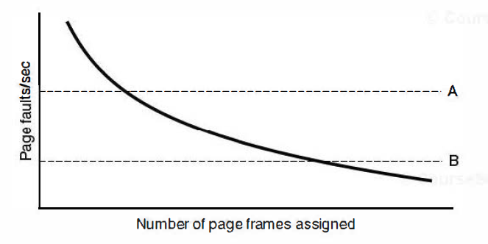
Local versus Global Allocation Policies
A global algorithm is used to prevent thrashing and keep the paging rate within acceptable bounds:
A：too high ➔ assign more page frames to the process.
B：too low ➔ assign process fewer page frames.
36

Slide 37
Page Size
Small page size
Advantages:
less internal fragmentation
Disadvantages:
programs need many pages → larger page tables
37

Slide 38
Page Size
Overhead due to page table and internal fragmentation
s = average process size in bytes,
p = page size in bytes,
e = page entry
page table space
internal fragmentation
Optimized when
38

Slide 39
Page Size
Example:
s = 1M
e = 8
==》 p = square root of (2(1M)(8)) = 4K
Common range:
512 <= p <= 64k
39

Slide 40
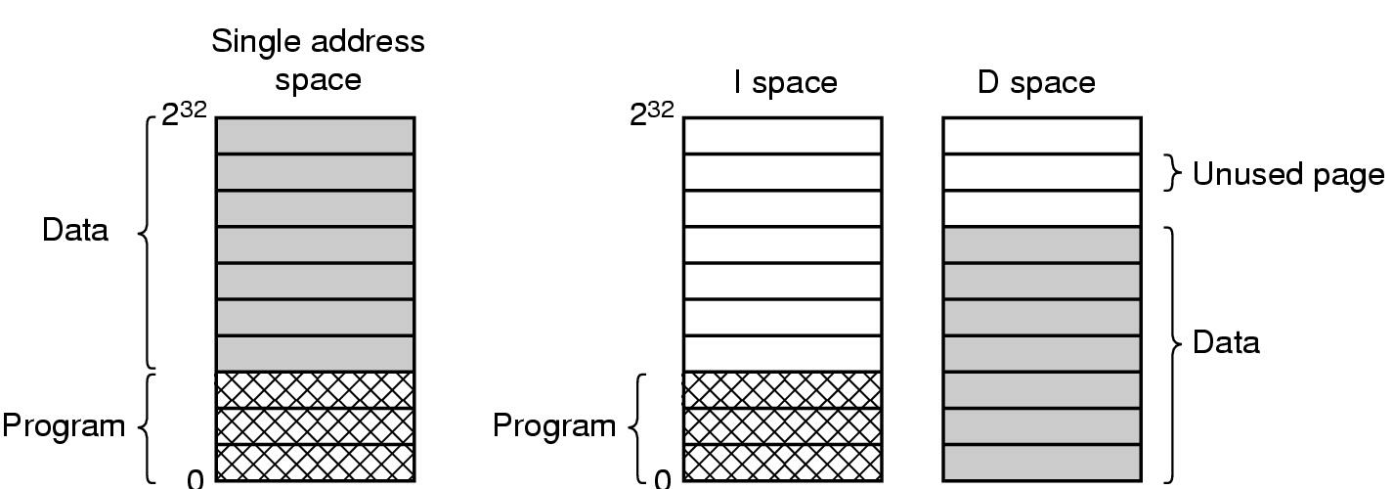
Separate Instruction and Data Spaces
Most systems separate address spaces for instructions (program text) and data. A process can have two pointers in its process table: one to the instruction page and one to the data page. A shared code can be pointed by two processes.
40

Slide 41
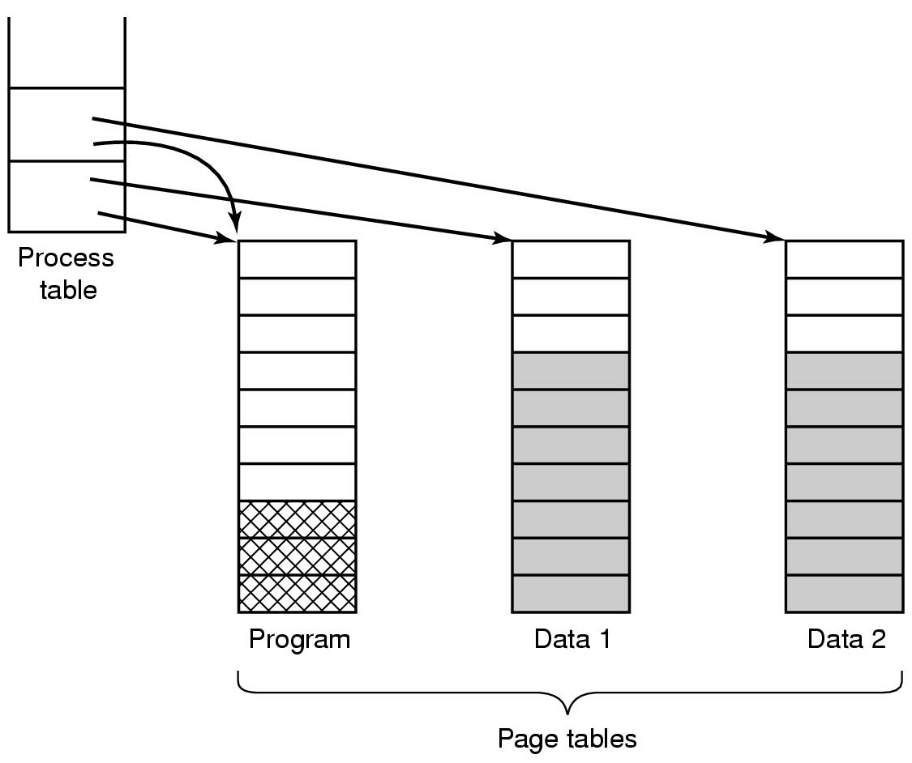
Shared Pages
Two processes sharing same program sharing its page table
41

Slide 42
Cleaning Policy
Paging Daemon:
A background process, in sleep state in most of the time;
Periodically woken up to inspect state of memory
When too few frames are free, selects pages to evict using a replacement algorithm.
42

Slide 43
Page Fault Handling
1. Hardware traps to kernel
2. Save general registers
3. Determines which virtual page needed
4. Seeks page frame
5. If the selected frame is dirty, write it to disk
6. Brings new page in from disk
7. Page tables updated
8. Instruction backed up to when it began
9. Faulting process scheduled
10. Registers restored & Program continues
43

Slide 44
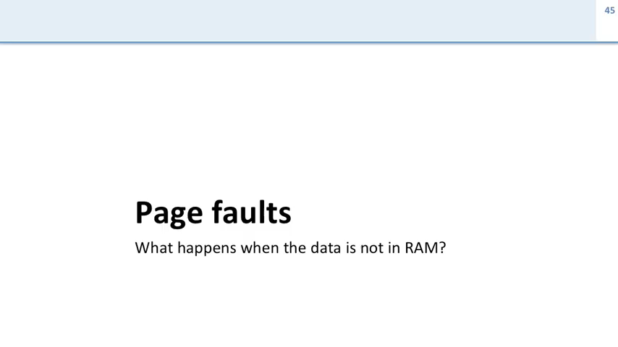

Slide 45
Locking Pages in Memory
Process issues call for read from device into buffer
while waiting for I/O, another process starts up
has a page fault
buffer for the first process may be chosen to be paged out
If a page transferring data through the I/O is paged out, it will cause part of the data in buffer and part in the newly loaded page. In this case, the page need to be locked (pinning).
45

Slide 46
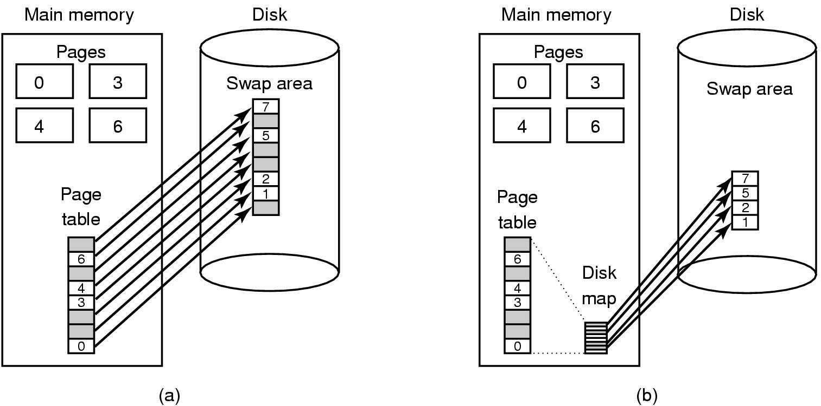
Backing Store
Two approaches to allocate page space on the disk:
1）Paging to static swap area
2）Backing up pages dynamically with a disk map
(a) Paging to static swap area； (b) Backing up pages dynamically.
46

Slide 47
主观题
1分
For a paging system with page tables in memory:
If it takes 0.2 microseconds to access memory, what is the effective access time?
If you add a TLB and assume that the probability of finding page table entries in the TLB is 90%, what is the effective access time? (assuming that the query time of the TLB is 0)
正常使用主观题需2.0以上版本雨课堂
作答

Slide 48
If it takes 0.2 microseconds to access memory, what is the effective access time?
Answer: 2 * 0.2 microseconds = 0.4 microseconds
2) If you add a TLB and assume that the probability of finding page table entries in the TLB is 90%, what is the effective access time? Answer: 0.9 * 0.2 microseconds + (1-0.9) * 2 * 0.2 microseconds= 0.22 microseconds

Slide 49
Check Points
What is the drawback of FIFO?
What is working set?
What is thrashing?
What is Belady’s anomaly ?
What is demand paging?

